Slide 1

Spark Installation
CSC 4760 / 6760 Big Data Programming
Spring 2020

Slide 2
Spark Installation
Verifying Java Installation: $ java -version
Verifying Scala Installation: $ scala -version
Downloading Apache Spark
Installing Spark
Verifying the Spark Installation: bin/pyspark or bin/spark-shell

Slide 3
Installing Scala
Install Scala:
$ sudo apt update
$ sudo apt install scala
$ scala -version
If you install Scala by using the above commands, no need to do the following steps.
Or download the scala package and install it manually:
http://www.scala-lang.org/download/
Download Scala Binaries for Unix (scala-2.13.1.tgz, the latest version)
Put the unzipped folder in the home directory “/home/rob/”
Edit the file ~/.bashrc in VS Code IDE, add the following two lines to the end of the file
export SCALA_HOME=/home/rob/scala
export PATH=$SCALA_HOME/bin:$PATH
$ scala -version
$ echo $SCALA_HOME

Slide 4
Installing Spark in Ubuntu 18.04
Download Spark : http://spark.apache.org/downloads.html
spark-3.0.0-preview2-bin-hadoop3.2.tgz
Unzip it and rename “spark-3.0.0-preview2-bin-hadoop3.2” to “spark”
Put it in the home directory : /home/rob/spark
Run “pyspark” or “spark-shell”
Edit ~/.bashrc in VS Code IDE // add the following two lines to the end of the file
export SPARK_HOME=/home/rob/spark
export PATH=$SPARK_HOME/bin:$PATH
export PYSPARK_PYTHON=python3

Slide 5
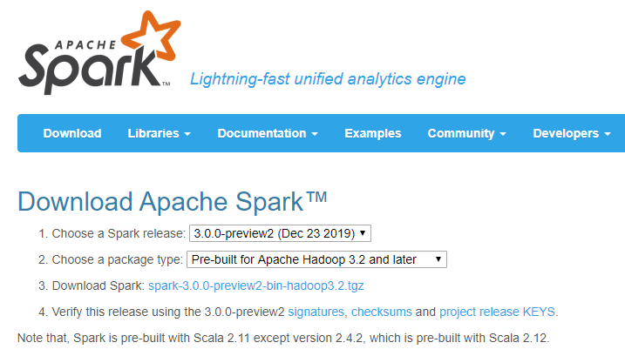
Install Spark
http://spark.apache.org/downloads.html

Slide 6
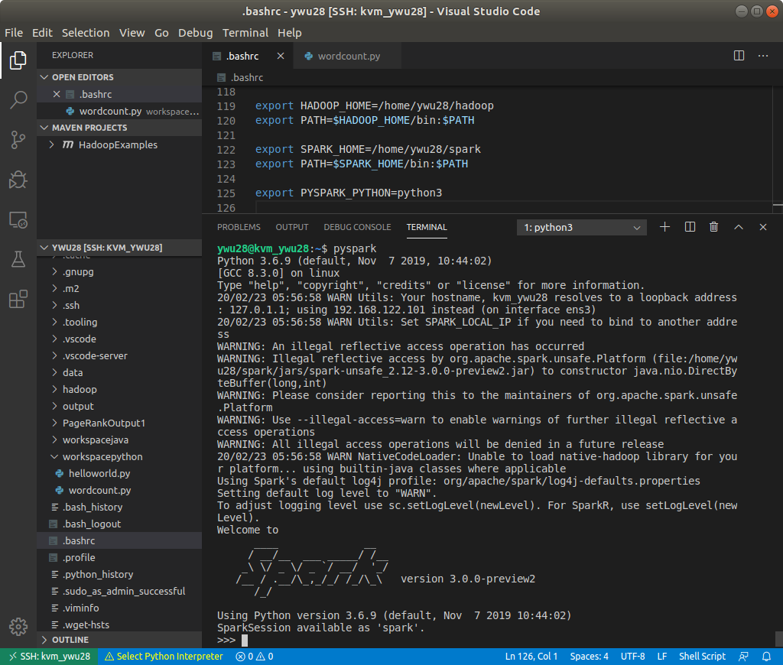
Run Pyspark
$ pyspark
For Python
You can also run
$ spark-shell
For scala

Slide 7
Spark’s Python and Scala Shells
Interactive Shells are available only in Python and Scala
Python
Scala
Batch/Standalone
Java
Python
Scala
The API is similar in every language.

Slide 8
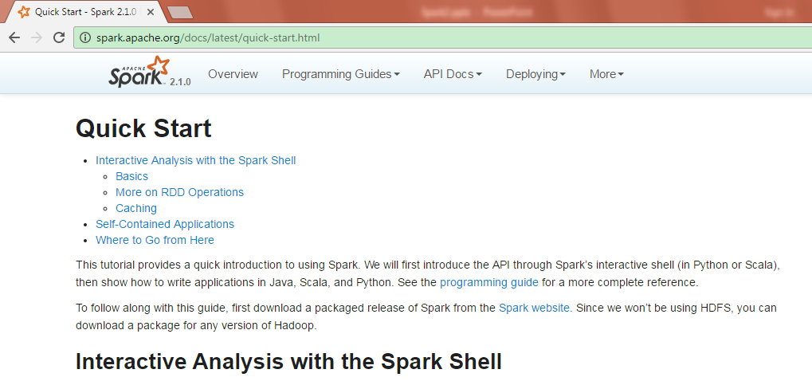
The Power of Spark’s Shells
Examples from the Quick Start Guide (http://spark.apache.org/docs/latest/quick-start.html)

Slide 9
Open up one of Spark’s shells
Python version of the Spark shell, a.k.a., PySpark shell
In the terminal, type: pyspark
Scala version of the Spark shell
In the terminal, type: spark-shell
Exit either shell: press Ctrl-D or input command : exit()

Slide 10
Create a RDD from a local text file (Python line count)
$ pyspark
>>> lines = sc.textFile(“/home/rob/Assignment1/test.txt") # Create an RDD called lines
>>> lines.count() # Count the number of items in this RDD
3
>>> lines.first() # First item in this RDD, i.e. first line of README.md
u'hadoop spark hadoop'
lines: An RDD

Slide 11
Create a RDD from a local text file (Scala line count)
$ spark-shell
scala> val lines = sc.textFile("/home/rob/Assignment1/test.txt") // Create an RDD called lines
lines: spark.RDD[String] = MappedRDD[...]
scala> lines.count() // Count the number of items in this RDD
res0: Long = 3
scala> lines.first() // First item in this RDD, i.e. first line of README.md
res1: String = hadoop spark hadoop
lines: An RDD

Slide 12
Read Data from Local FS or from HDFS
Read the text file from the local file system
book1 = sc.textFile(“/home/rob/data/peterpan.txt”)
Read the text file from HDFS
book2 = sc.textFile(“hdfs://localhost:9000/user/rob/data/peterpan.txt”)
host:port/directory localhost=127.0.0.1

Slide 13
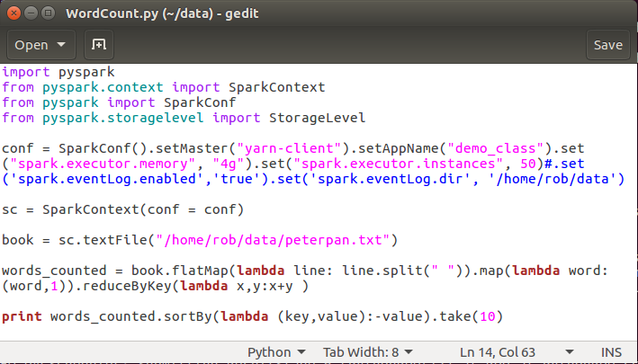
WordCount in Spark
$ spark-submit WordCount.py
output

